Slide 1

Big Mart sales Prediction
Internship Details on ML Project
Team
Name Guide
Prasad B N
Nirmal rao s
Charan k A
Akash Adiga
Lakshmi kanth T M
Dhanush HK
Prof Deeraj
HOD,Prof Subburaj T
HOD,Prof Subburaj T
DR Mageusha
DR Annu sharma

Slide 2

Rajarajeshwari College of Engineering
Vision
TO PROVIDE AN OPEN OPPORTUNITY TO YOUNG GENERATION FOR EVOLVING THEIR CORE COMPETENCIES HELPING THEM TO BUILD THEIR CAREER AS GLOBAL PROFESSIONALS TO BE AN AUTONOMOUS INSTITUTION BY ACHIEVING EXCELLENCE IN THE FIELD OF HIGHER EDUCATION.
Mission
TO CONSISTENTLY STRIVE FOR ACADEMIC EXCELLENCE TO BECOME A LEADING INSTITUTION IN THE FIELD OF ENGINEERING, MANAGEMENT AND RESEARCH TO PRODUCE COMPETENT AND ETHICALLY SOUND MANPOWER FOR THE BENEFIT OF INDUSTRY, SOCIETY, NATION AND THE GLOBAL ENVIRONMENT.

Slide 3
Department of Master of Computer Application
Vision
TO BE A DEPARTMENT OF EXCELLENCE IN TECHNICAL EDUCATION, WIDELY KNOWN FOR THE DEVELOPMENT OF APPLICATION DEVELOPERS, IT PROFESSIONALS, ENTREPRENEURS, RESEARCHES CREATES BENEFIT ALL OF HUMANITY..
Mission
TO ENSURE DIVERSE KNOWLEDGE INTEGRATION WITH INDUSTRY FOR CREATIVE LEARNING AND APPLICATION.
TO NUTURE TALENT IN USAGE OF APPLICATION OF DIGITAL INTELLIGENCE AND USE OF POWER OF TECHNOLOGY.
TO CREATE ENTREPRENEURS THRO INCUBATING TECHNOLOGY BUSINESSES AND COMMITTE TO CREATE AND SUSTAINING TO BE SOCIETAL RELEVANT EDUCATION.
TO ENSURE THE STUDENT CONNECT AT PERSONAL LEVEL AND FOCUS.

Slide 4

About Company
Indigeneous Tech Private Limited is a Private incorporated on 20 March 2018.
It is classified as Non-govt company and is registered at Registrar of Companies, Bangalore. Indigeneous Tech Private Limited's Annual General Meeting (AGM) was last held on N/A and as per records from Ministry of Corporate Affairs (MCA), its balance sheet was last filed on 31 March 2021.
Directors of Indigeneous Tech Private Limited are Muthuram Govindarasu and Chitra Muthuram.

Slide 5
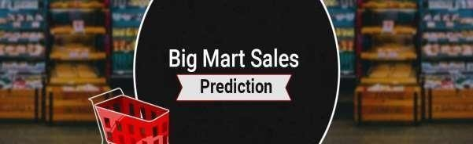
Introduction
The "BIG MART SALES" will be is predicted using machine learning techniques. A number of features, such as Item Fat Content, Item Type, Outlet Identifier, Outlet size , Outlet Location Type, Item MRP. will be used to produce the Sales. In order to find meaningful and useful patterns in vast amounts of data, predictive analysis uses computational approaches.

Slide 6
Week One
Orientation of Machine learning internship.
Software Requirements to Software Maintenance.
Python Basics, Set up Google Colabaratory.
Week two
Python Basics for ML.
Python Numpy Library.
Python Pandas Library.
Python Matplotlib, Scikit and Seaborn Libraries.
Overview of ML Supervised Learning (Regression).

Slide 7
Week Three
Types of Machine Learning.
Supervised Learning.
Unsupervised Learning.
ML Regression in Detail.
ML Classification in Details.
Week Four
Offline Presentation of the Project.
Testing.
Documentation of Project.

Slide 8
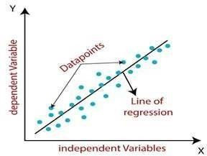
used Algorithms…
Logistic regression is one of the most popular Machine Learning algorithms, which comes under the Supervised Learning technique. It is used for predicting the categorical dependent variable using a given set of independent variables.
Linear Regression Algorithm: Linear Regression finds the linear relationship between the Dependent variable and one or more Independent variables using a best-fit straight line. Generally, a linear model makes a prediction by simply computing a weighted sum of the input features, plus a constant called the bias term. In this technique, the dependent variable is continuous, the independent variable(s) can be continuous or discrete, and the nature of the regression line is linear

Slide 9
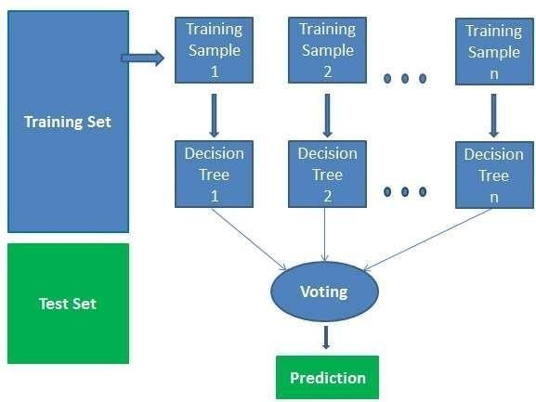
Random Forest Classifier: Random Forest is a Supervised Machine Learning Algorithm. It can be used both for Classification and Regression. It is also the most flexible and easy to use algorithm. A forest is comprised of trees. It is said that the more trees it has, the more robust a forest is. Random forests create decision trees on randomly selected data samples, gets prediction from each tree and selects the best solution by means of voting. It also provides a pretty good indicator of the feature importance.

Slide 10
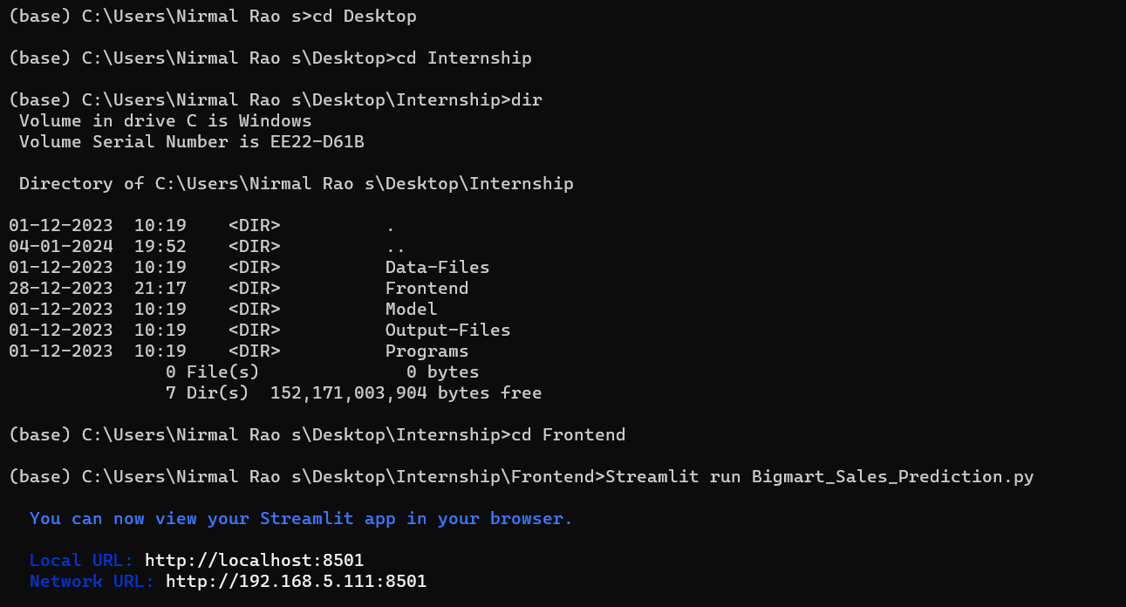
Out Put SnapShot

Slide 11
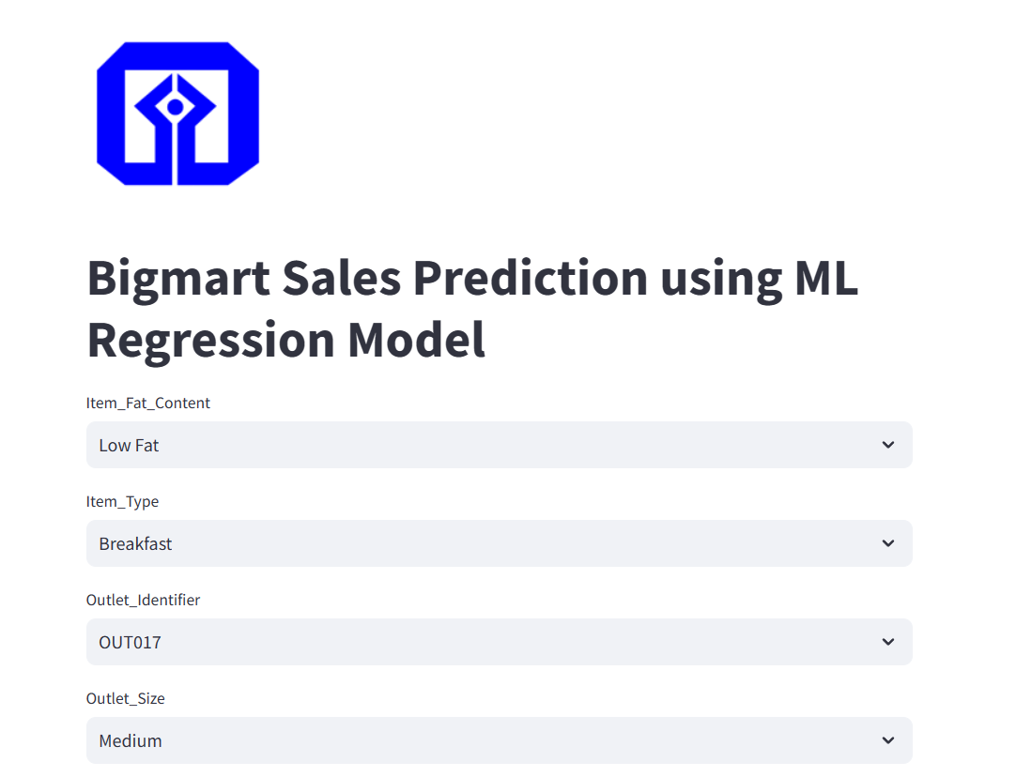

Slide 12
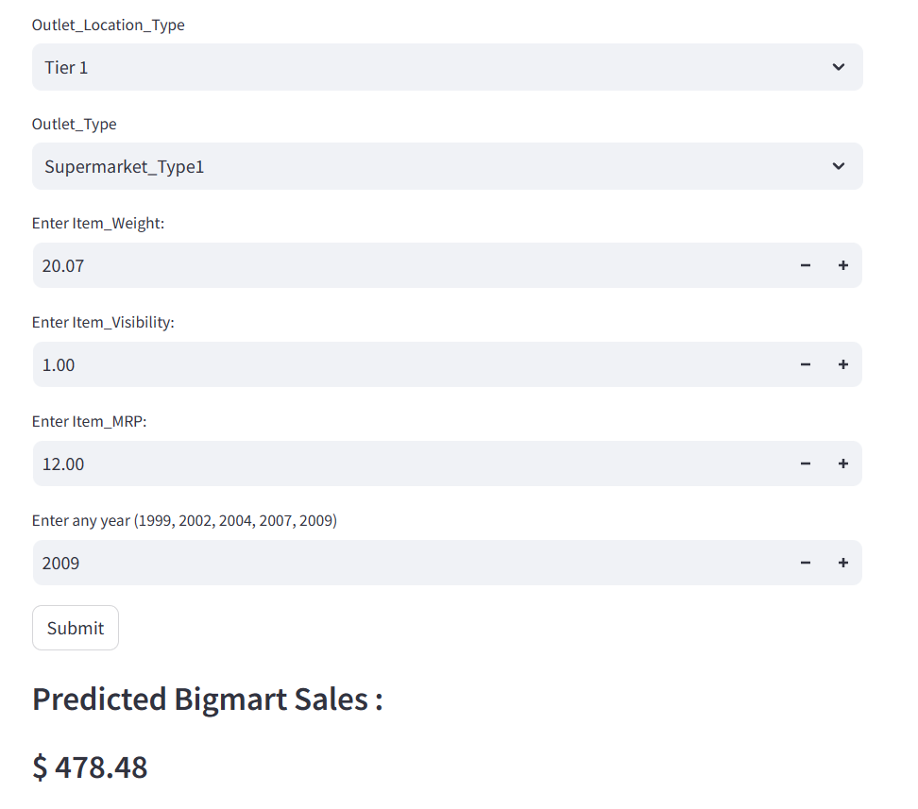

Slide 13
conclusion
With several characteristics, the suggested method predicts the Big mart sales. We experimented with different Machine Learning algorithms to get the best model. When compared to all other algorithms, the Random Forest Regression achieved Best Predection. Flask was used to create the website. Let’s see how our project pans out. Open the HTML web page we generated and run the app.py file in the backend. Input the Item Fat Content, Item Type, Outlet Identifier, Outlet size, Outlet Location Type, Enter Item MRP, then click ‘Submit.’ Predicted Bigmart Sales will be displayed.

Slide 14
Reference
The Jupiter Note book:-
https://jupyter-notebook.readthedocs.io/en/stable/notebook.html
Python:-
https://www.geeksforgeeks.org/pep-8-coding-style-guide-python/
Regression:-
https://www.geeksforgeeks.org/types-of-regression-techniques/

Slide 15
Thank you

